Slide 1


Female reproductive system
Physioloize it to visualize it….
By: Dr. Mazin S. A. M
MBBS, Bogomolets National University….
Diploma in Research methodology and biostatistics, University of science and Technology….
Cardiology MD, Saransk city, Russian Federation….
Masters degree in human physiology, Ribat National University….
Masters degree in Molecular medicine, Khartoum University….

Slide 2
Just a reminder…..
The female organs of reproductive Include the following:
The ovaries: these constitute the primary sex organs in females, perform the following function:
Exocrine function(production & extrusion of ova)
Endocrine function(secretion of estrogen, progesterone & inhibin as well as relaxin & small amount of testosterone)

Slide 3
Clinical note aside!!!!
The number one reason that a women seeks a medical opinion is menstrual irregularities

Slide 4
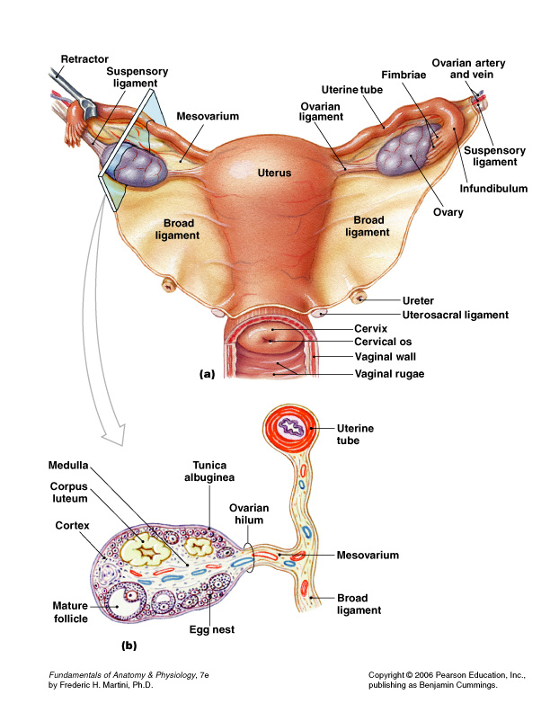

Slide 5
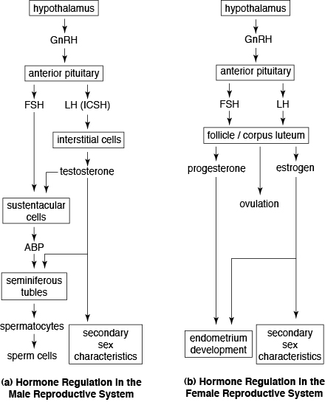
Reproductive hormones over-view

Slide 6
Some general rules….
Term pregnancy is 37-42 weeks
Post-term is more than 42
Preterm is less than 37
Average weight of a child is around 2000-2500 g
SGA-Small for gestational age
LGA-Large for gestational age

Slide 7
Reproductive genetics
The following slide shows the human karyotype 9including the autosomes and gender chromosomes)

Slide 8
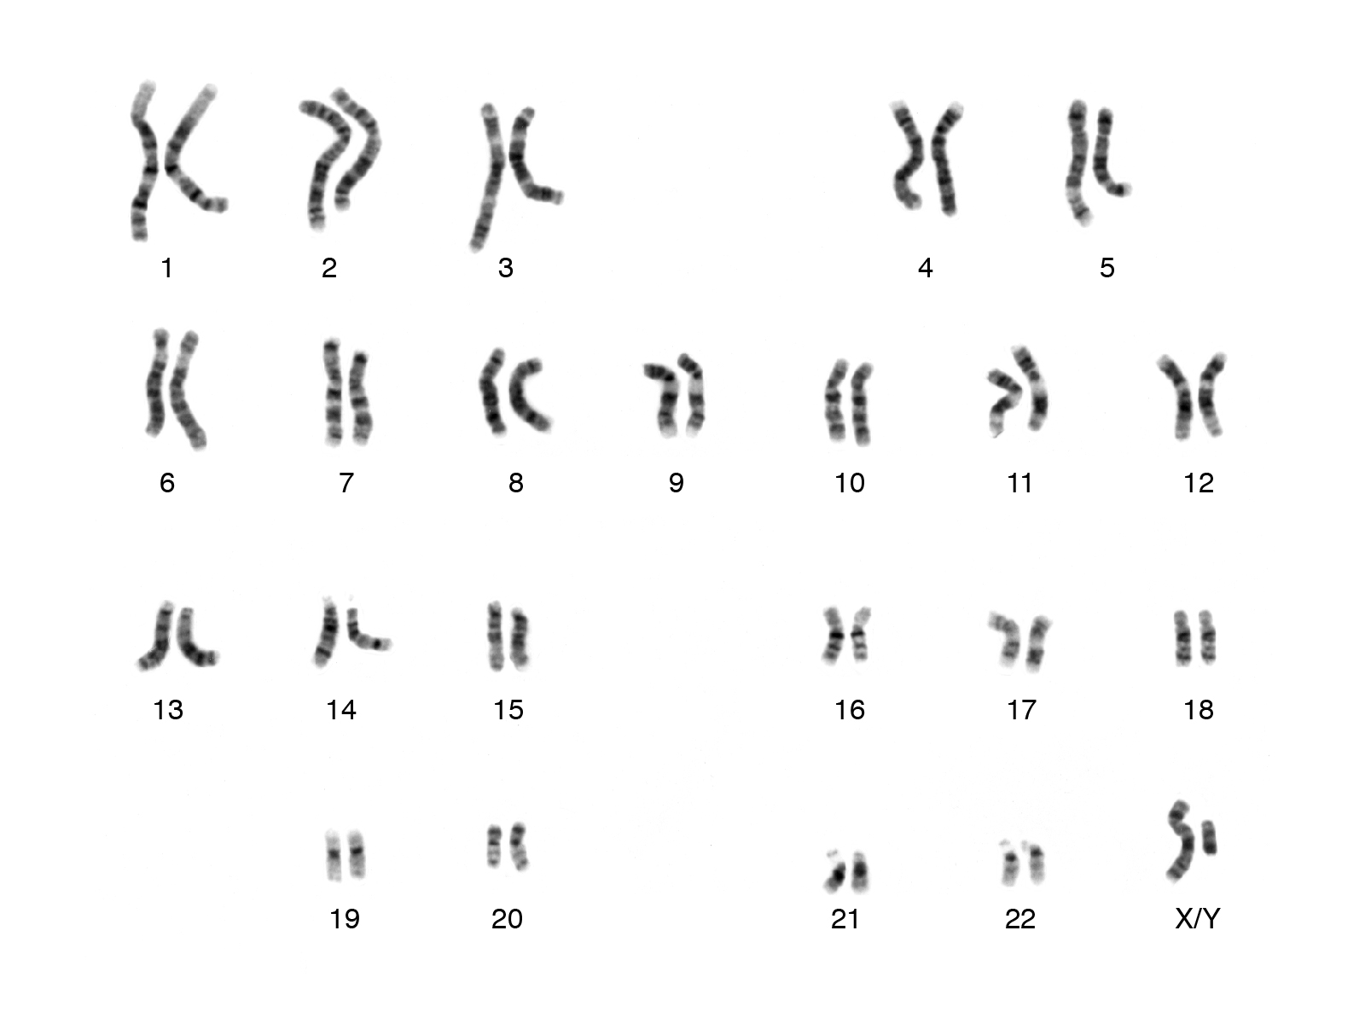

Slide 9
Prenatal Development.
Infancy and Toddlerhood.
Early Childhood.
Middle Childhood.
Adolescence.
Early Adulthood.
Middle Adulthood.
Late Adulthood

Slide 10
Adolescence vs. puberty
When the are activated by gonadotropins from the pituitary to bring about the final maturation of the reproductive system. This period of final maturation is known as adolescence. It is often also called puberty, although puberty, strictly defined, is

Slide 11
Adolescence vs. puberty
the period when the endocrine and gametogenic functions of the gonads have first developed to the point where reproduction is possible

Slide 12
In females….
In girls, the first event is thelarche, the develop- devel_x0002_ment of breasts, followed by pubarche, the development of axillary and pubic hair, and then by menarche, the first menstrual period.
Adrenarche-an increase in adrenal androgens.

Slide 13
Control of the Onset of Puberty
Reaching puberty is a process which can be explained by environmental as well as genetic factors
The inhibition on GnRH is lifted and this stimulates the gonads..

Slide 14
PRECOCIOUS & DELAYED PUBERTY
Precocious pseudopuberty-developing the secondary characteristics without gametogenesis
True precocious puberty due to an early but otherwise normal pubertal pattern of gonadotropin secretion from the pituitary

Slide 15
List of causes
Precocious pseudopuberty
True precocious puberty
Androgens secreting tumors in males
Granulosa cell tumors in females
Adrenal
Constitutional
Cerebral
Tumors
Infections
Developmental abnormality

Slide 16
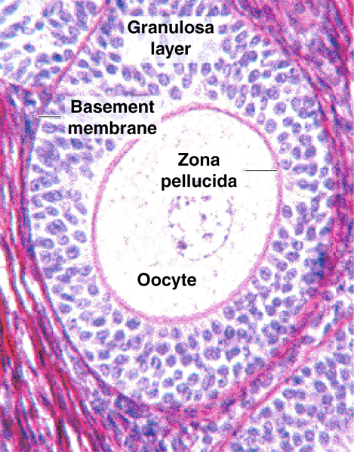
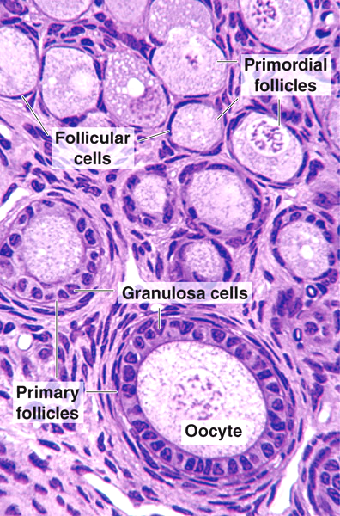

Slide 17
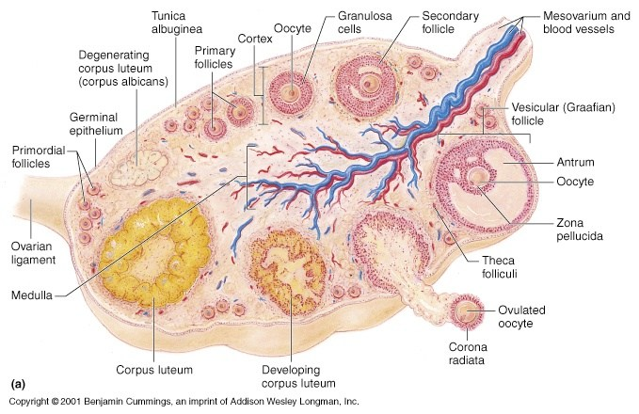

Slide 18
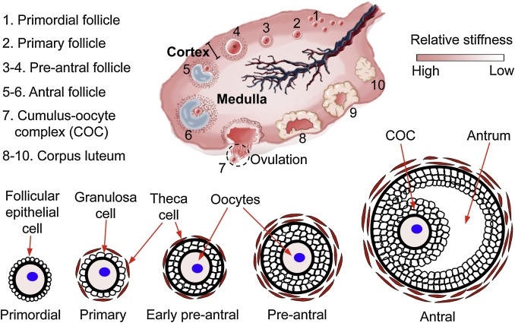

Slide 19
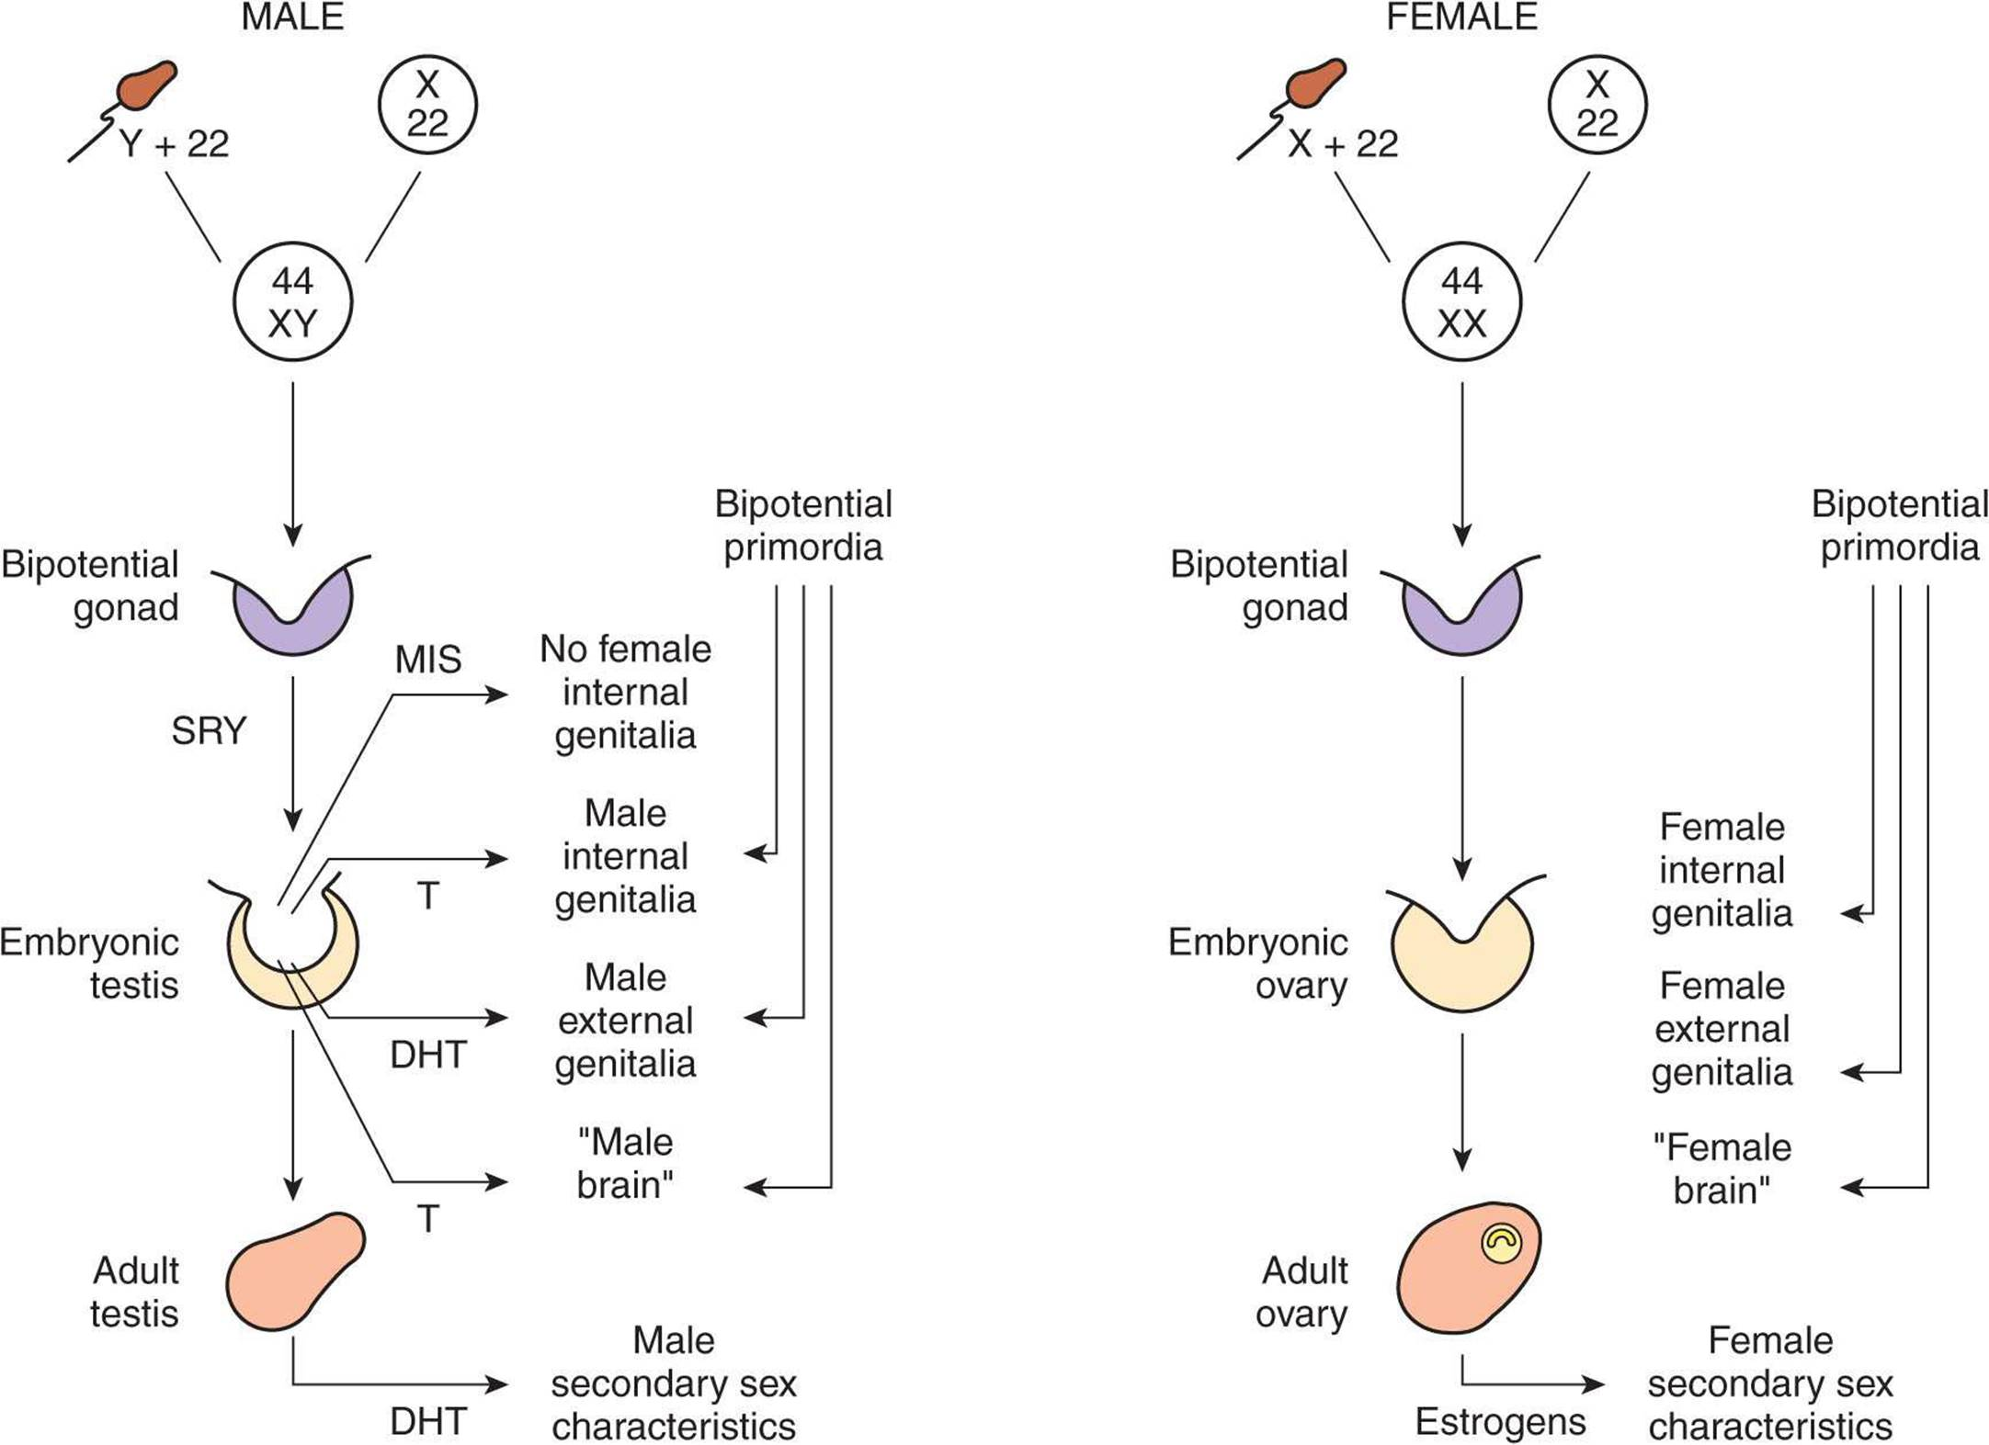

Slide 20
Naegle’s rule also allows us to
1-10 days
Proliferative (Oestrogen dominated)
10-14
Ovulatory (LH)
14-28
Luteal (secretory) Progesterone dominated

Slide 21
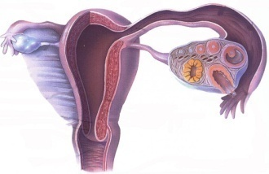
The menstrual cycle
Cyclic changes in the female that occur in the:
Ovaries (ovarian cycle)
Uterus (uterine cycle)
Other organ (e.g. cervix, vagina & breast)
These change start to occur following puberty & cease at the age of menopause
They can be regarded as periodic preparations for fertilization & pregnancy
The average duration of each cycle is about 28 days

Slide 22
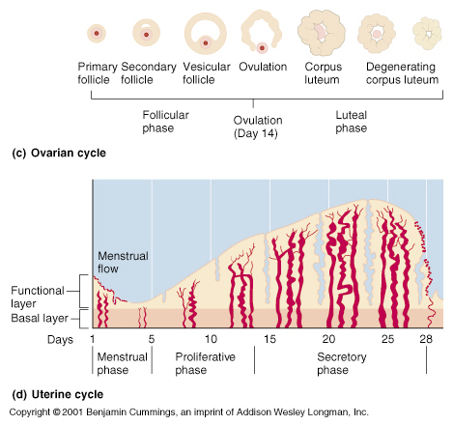

Slide 23
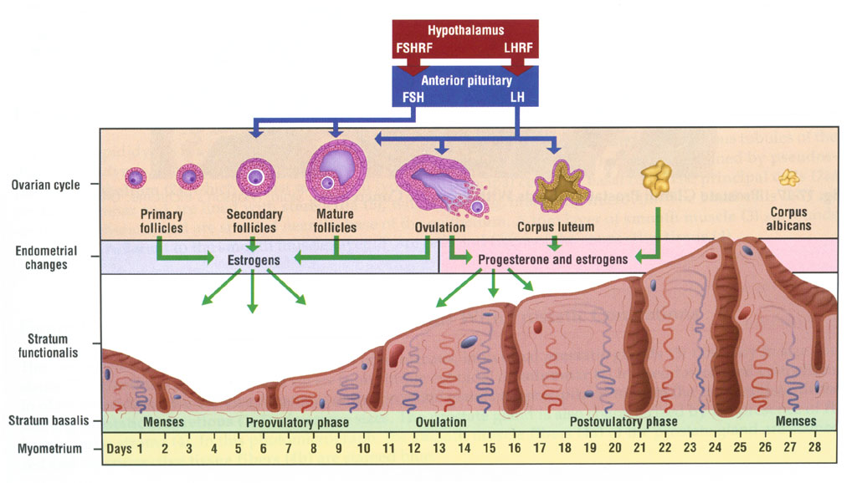

Slide 24
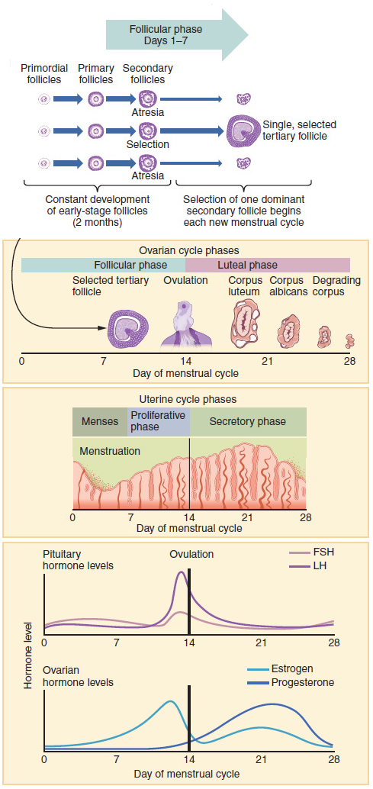
In a nutshell

